Slide 1
FOOTBALL MATCH PREDICTION
Machine Learning (CS 580L)
Instructor- Arti Ramesh
Project by-
Bhuvan Chadha Aravind Padmanabhan Qi Pei

Slide 2
Introduction to the problem
Sports result prediction has always been hard because of the influence of a number of aspects in a match, with each feature (such as results of historical matches, player performance indicators, and opposition information) playing a different role in different matches of a tournament. The results of a prediction are always crucial for the players, bidders and fans. Today, probably all the data of every professional sports match is recorded, formulated, analyzed statistically and stored in formal databases and is an open source for computer scientists (and to the general public) and analysts to develop intelligent models to predict future match results.

Slide 3
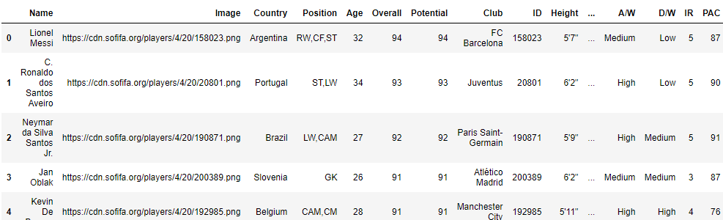
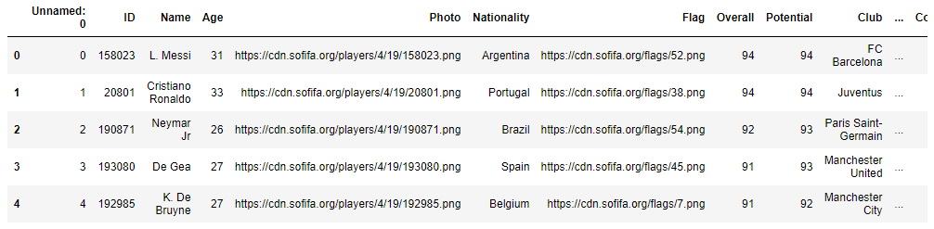
Datasets

Slide 4
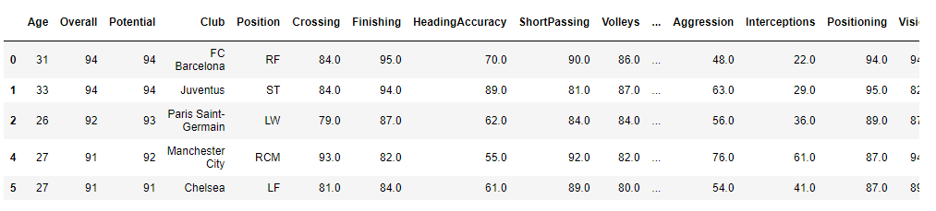
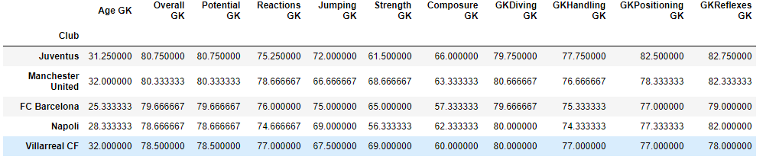
Datasets

Slide 5
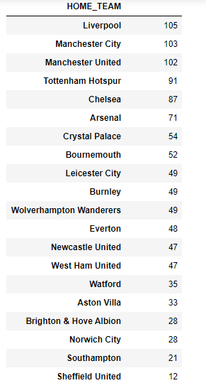
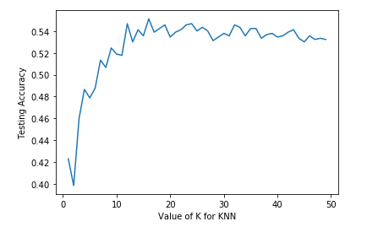
FINAL RESULTS

Slide 6
What we learned
Data Set
Teamwork

Slide 7
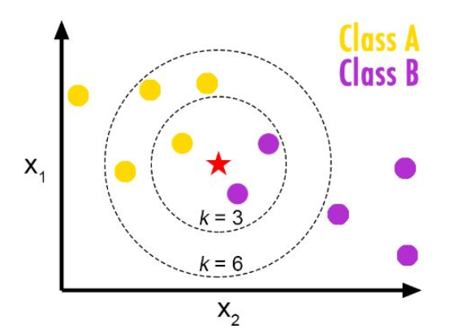
Machine learning model used
K- NEAREST NEIGHBOUR

Slide 8
K NEAREST NEIGHBOUR
Concept
Simple form – We match the test sample to existing data points based on some distance or proximity metric. In this project, for e.g., if a team has won previous games on a particular field, against a particular opponent, a considerable number of times than the losses, then the prediction will be a ‘win’ in the next game in the similar conditions.
When to choose KNN Model?
Instant map to points
Less than 20 attributes per instance
A lot of training data

Slide 9

Advantages of KNN Model
Training is fast
Works well with historical data
Does not lose information
Robust to noise
Works great with the classification of data
Disadvantages of KNN Model
Slow at query time
Easily fooled by irrelevant attributes
Slow with high dimensional data (Curse of Dimensionality)

